Slide 1
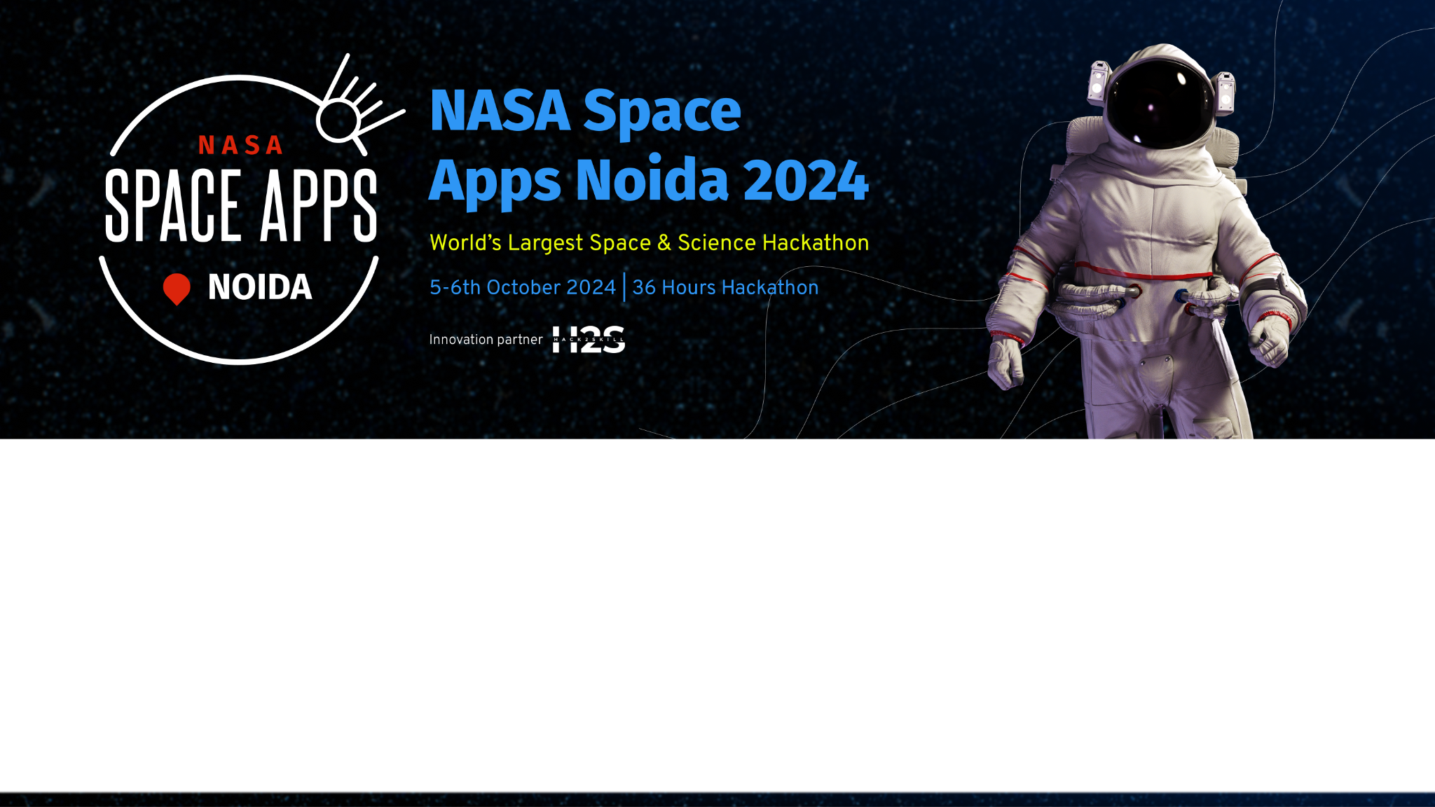
Team Details
Team name: Astro Analyst
Team leader name: Harsh Mishra
Problem Statement: Leveraging Earth Observation Data for Informed Agricultural Decision-Making.

Slide 2
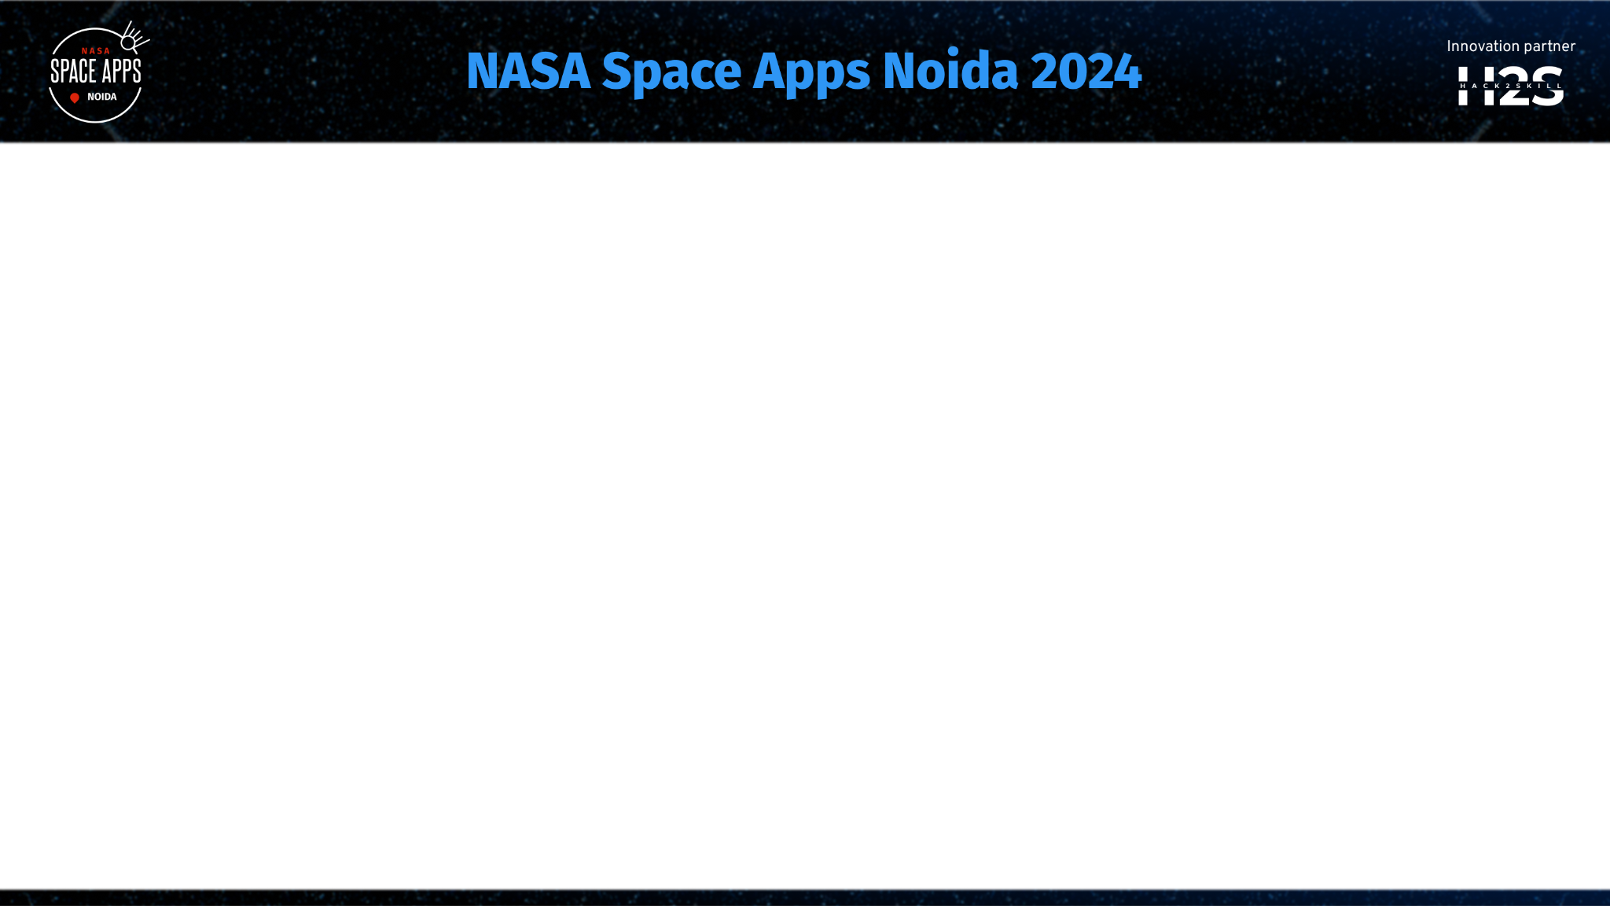
Brief about the idea
Idea : Leveraging Earth Observation Data for Informed Agricultural Decision-Making
This tool will give the farmers an easy approach to explore, analyze, and apply NASA datasets in answering their questions related to water and help inform their farm practices. It shall give support to the farmers in overcoming the problems that their crops may be experiencing due to uncontrollable conditions from weather, pests, and diseases.
The proposed solution is divided into five major steps:
Study several different datasets by NASA
Tool design
Implementation of analysis on data
Integration of NASA datasets
To test and refine
This tool should provide an interface for farmers, through which they easily apply and analyze various datasets provided by NASA to make informed decisions on farming. Ultimately, this would ensure higher yields at minimal loss and ensure food security.
The idea can therefore go a long way in helping to prosper the agricultural sector in countries where water-related challenges are common. With advanced analytics using datasets provided by NASA, farmers will get insights to optimize farming practices and see improved livelihoods.

Slide 3
Opportunities
How different is it from any of the other existing ideas?
How will it be able to solve the problem?
USP of the proposed solution
How does it differ from any of the other existing ideas?
The uniqueness of the proposed solution lies in the fact that it will integrate with NASA datasets, will contain a holistic approach, and also feature a user-friendly interface with advanced analytics.
How will it be in a position to solve the problem?
The solution will have an intuitive interface that will enable users to create interactive and immersive visualizations, integrate several data sources, and share knowledge collaboratively to reach a wider audience in regard to complicated space science data.
USP of the Proposed Solution
The solution shall have unique selling propositions: multiple data source integration, interactive and immersive visualization, and focus on biological space experiments, making it comprehensive and interesting while visualizing space science data.

Slide 4
List of features offered by the solution
Integration with NASA Datasets: Full-scale access to high-quality datasets from NASA is provided for accuracy, reliability, and completeness of information
Holistic Approach: Understand the challenges of farmers related to water subjection by unpredictable and random occurrence of weather, pests, and diseases
User-Friendly Interface: Seamless access to and analysis of NASA datasets for farmers
High-Capacity Analytics: Integration of machine learning and data visualization goes beyond simple visualization to give actionable insights and recommendations
Predictive Analytics: Leverage advanced predictive analytics in order to provide farmers with predictive insight on weather patterns, soil moisture, and crop health
Real-time monitoring of crop health to detect the problems of pests, diseases, and other issues and act upon them straight away.
Data-driven decision-making regarding irrigation, planting, and harvesting by showing insights to farmers.
Resource optimization for reduced wastages and better farming operations.

Slide 5
Process flow diagram of idea – “Leveraging Earth Observation Data for Informed Agricultural
Decision-Making.”
Step 1: Data Ingestion
Ingestion of NASA datasets into the system ingestion of more data from various sources, like weather stations and soil sensors
Step 2: Data Processing
cleaning data, processing it, and analyzing it by machine learning algorithms extract insight using advanced analytics and visualization techniques.
Step 3: Predictive Modeling creation of predictive models based on historical data and machine learning algorithms model predictions on weather patterns, soil moisture, and crop health
Step 4: Real-Time Monitoring Data in real time from several sources is received, including but not limited to weather stations and soil sensors. Monitor real-time crop health to identify pest and disease attacks quickly.
Step 5: Insights and Recommendations Actionable insights and recommendations based on predictive models and real-time data Insights provided to farmers via an easy-to-view user interface
Step 6: Data-Driven Decision Making Farmers are notified about the right time for irrigation, planting, and harvesting based on the data-driven insights. Make decisions that minimize waste and maximize farming operational efficiency.
Step 7: Resource Allocation Resource allocation shall be done according to the insight drawn from data, in seeking to optimize farming operations. Resource allocation will be kept under constant monitoring with further adjustments, in pursuit of peak efficiency.
Step 8: Feedback Loop Collect feedback from farmers and other stakeholders to make improvements to the system. The feedback helps the system fine-tune predictive models and improve itself in general.

Slide 6
Architecture diagram of the proposed solution
NASA DATA API
ADDITIONAL DATA RESOURCES
DATA INGESTION LAYER
DATA PROCESSING ENGINE
DATA STORAGE
INSIGHTS GENRATION
REALTIME PROCESING
REAL TIME DATA INGESTION
MODEL STORAGE
MACHINE LEARNING ENGINE
USER INTERFACE
DECISION SUPPORT SYSTEM
OPTIMISATION ENGINE
RESOURCE ALLOCATION ENGINER
TECHNOLOGY STACK
FEEDBACK ANALYSIS
FEEDBACK COLLECTION
RESOURCE MONITORING

Slide 7
Technologies to be used in the solution
Programming Languages:
Python
Data Storage:
Relational databases (e.g., MySQL)
Machine Learning Frameworks:
TensorFlow
PyTorch
Scikit-Learn
Data Visualization Tools:
Power BI
Additional Technologies:
APIs (e.g., NASA Data API) for data ingestion
Data processing and analytics tools (e.g., Apache Spark, pandas)
Real-time data processing and streaming tools (e.g., Apache Kafka, Apache Flink)
Containerization and orchestration tools (e.g., Docker, Kubernetes)
Security and authentication tools (e.g., OAuth, SSL/TLS)

Slide 8
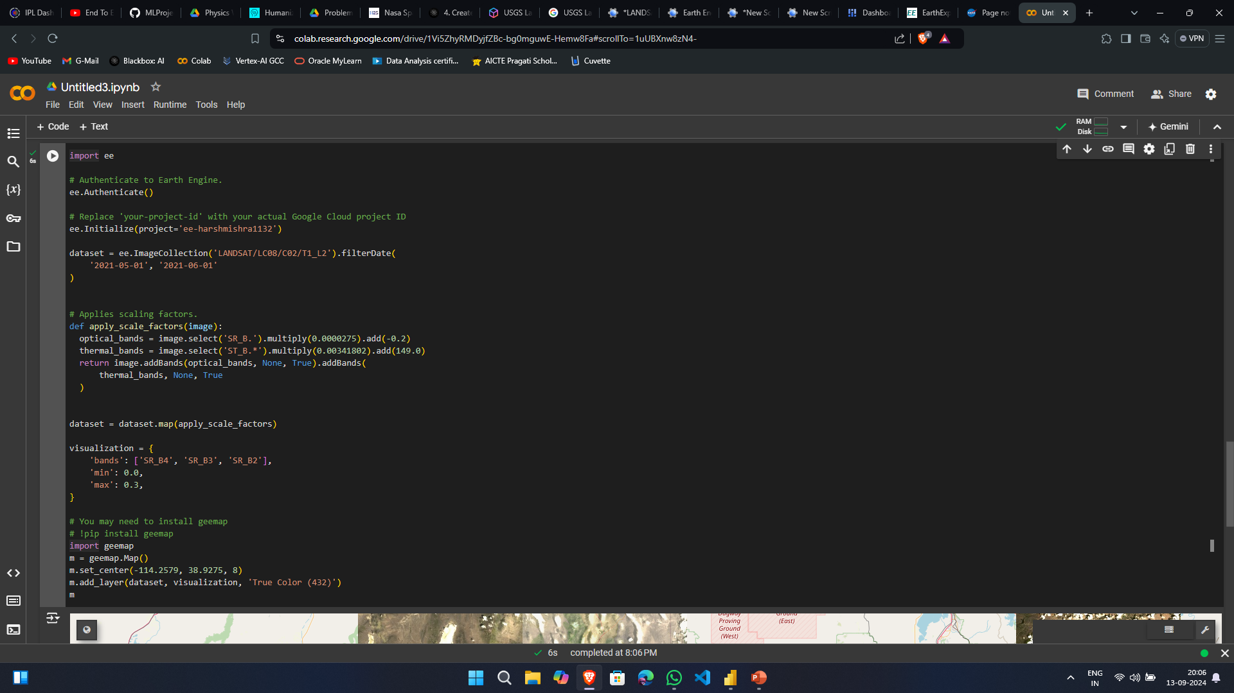
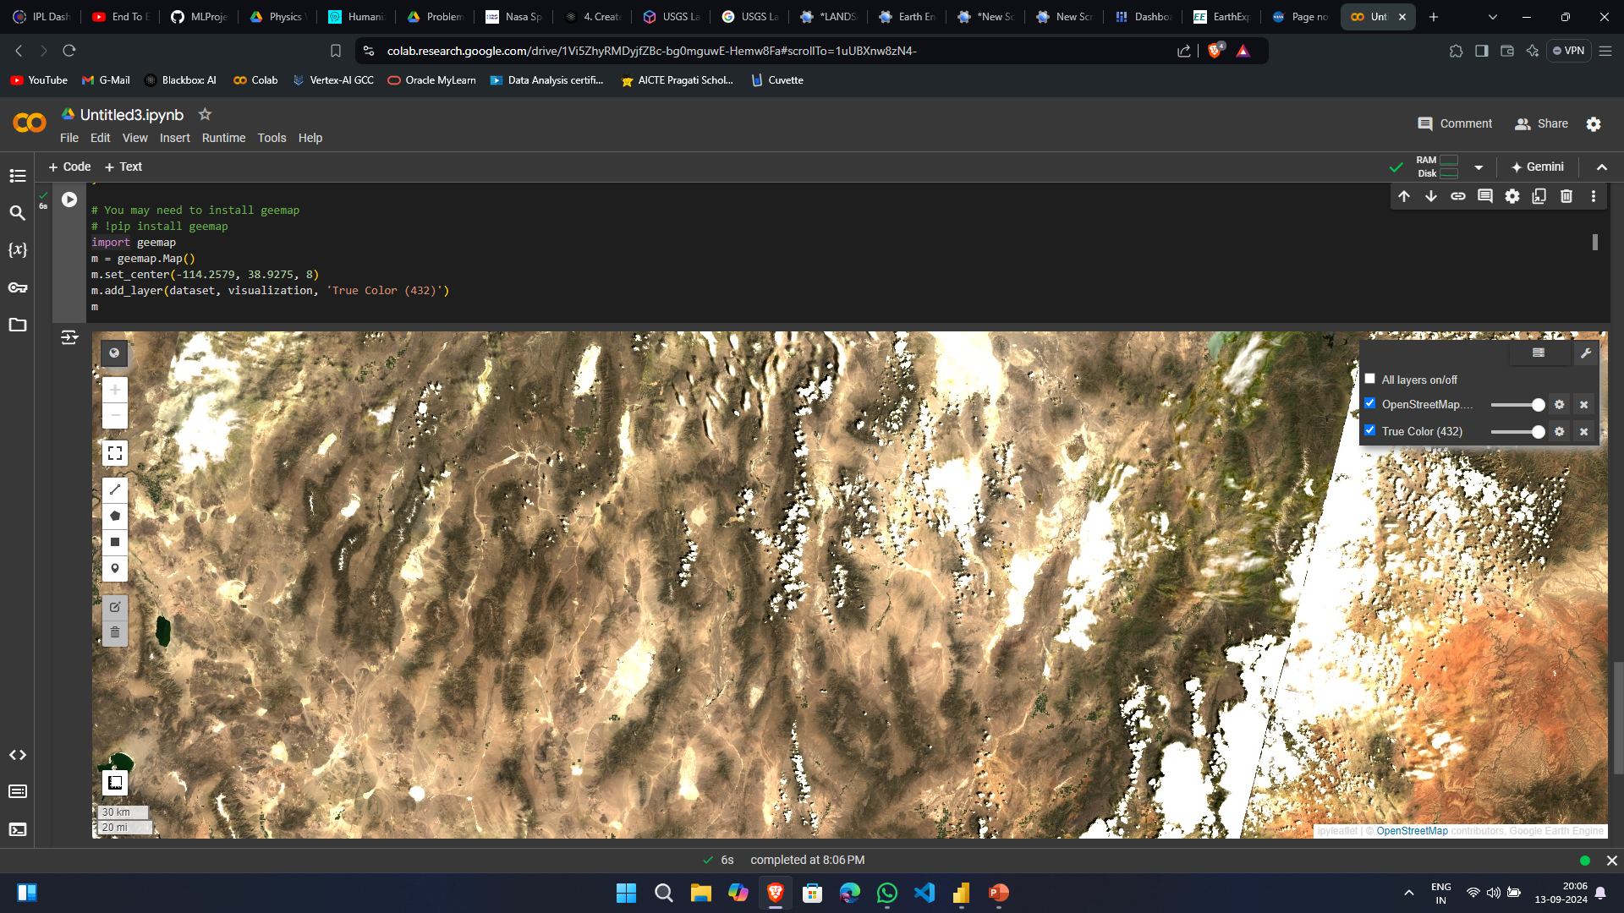
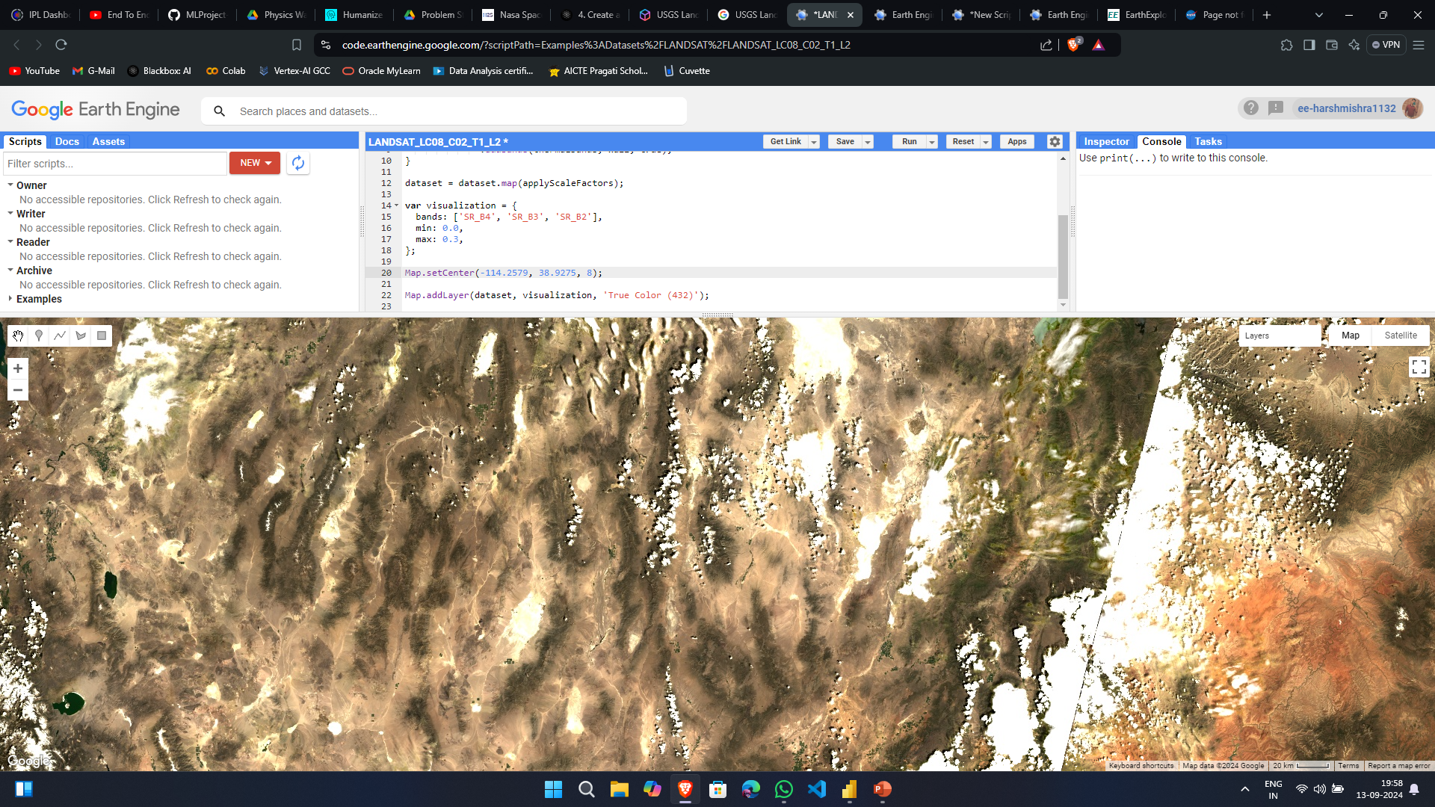
Snapshots of the prototype

Slide 9
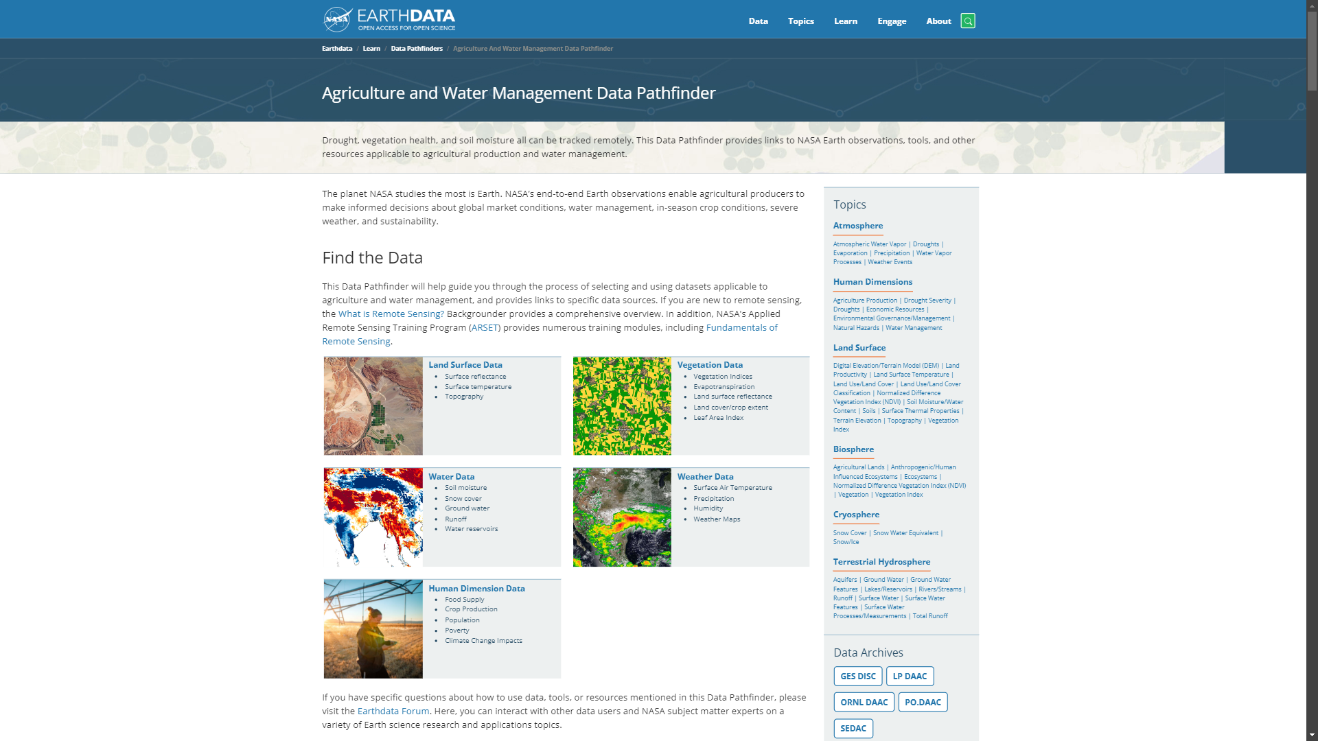
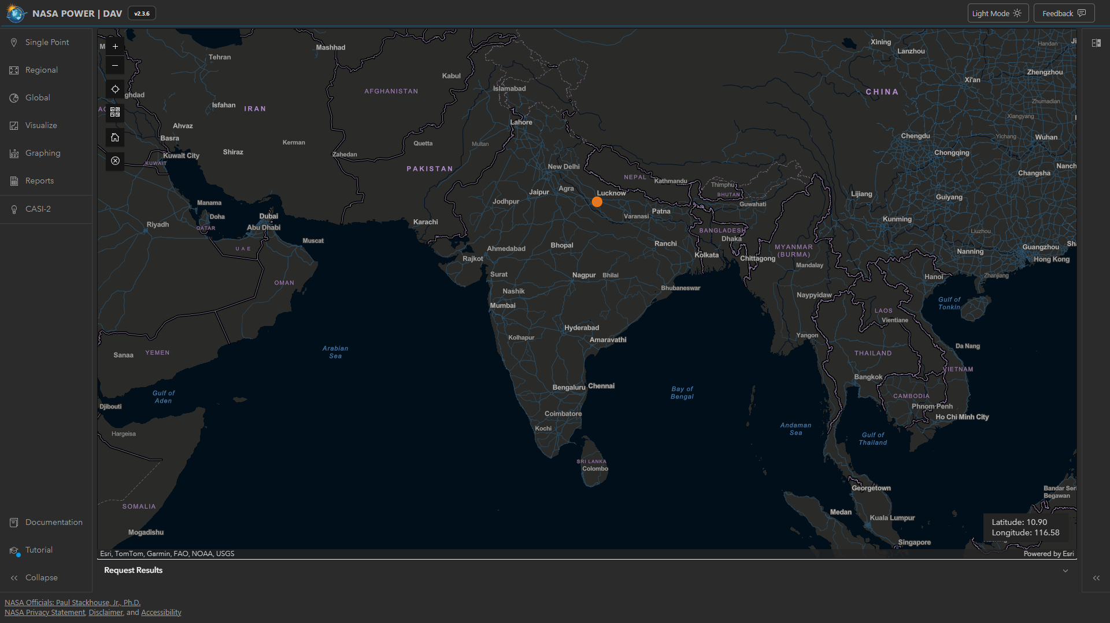
Used NASA Earth dataset official website for searching dataset
Used NASA online software for downloading Dataset (.nc) format
Downloaded the Weather Data and Human Dimension data ( especially for farmer’s)
Which consist of different parameter
Minerals like N, P, K
Temperature
Humidity
Rainfall
https://drive.google.com/drive/folders/1gZ4yRFot4DGd3aIFx942iaT_c8F9Gng3?usp=drive_link
use this drive link to access the all datasets which I have downloaded and extracted from NASA website

Slide 10
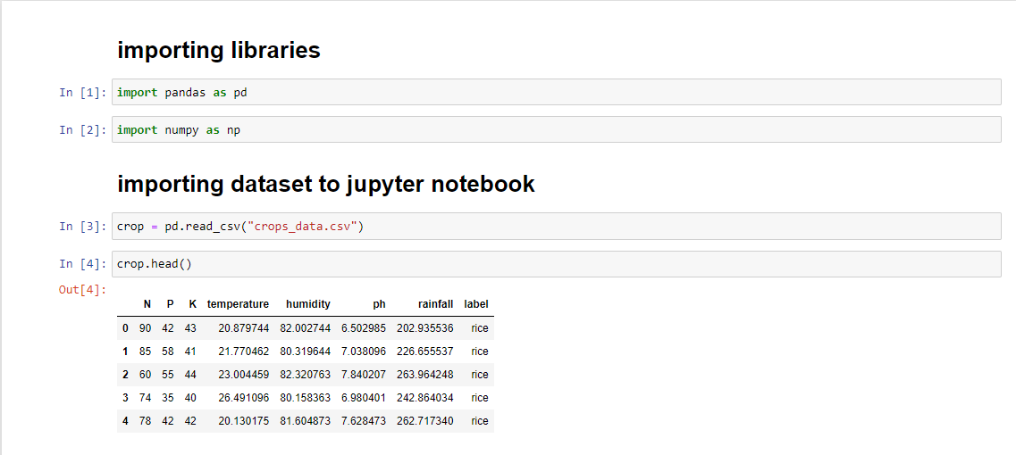
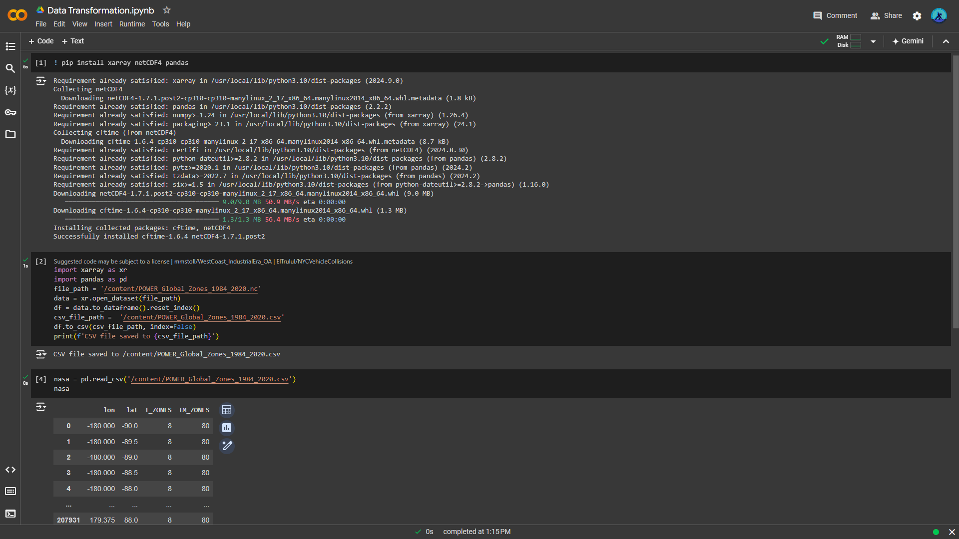
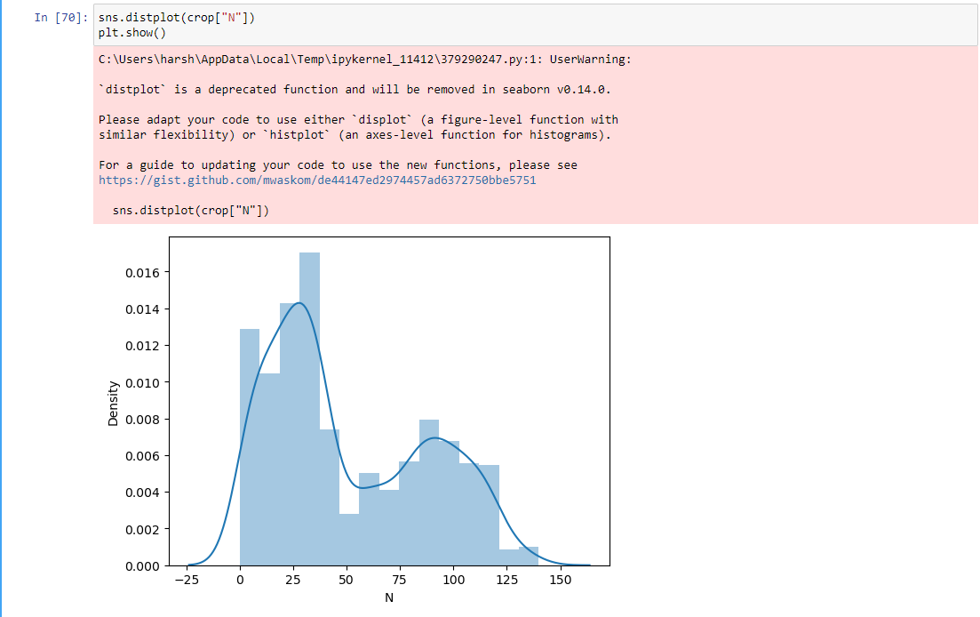
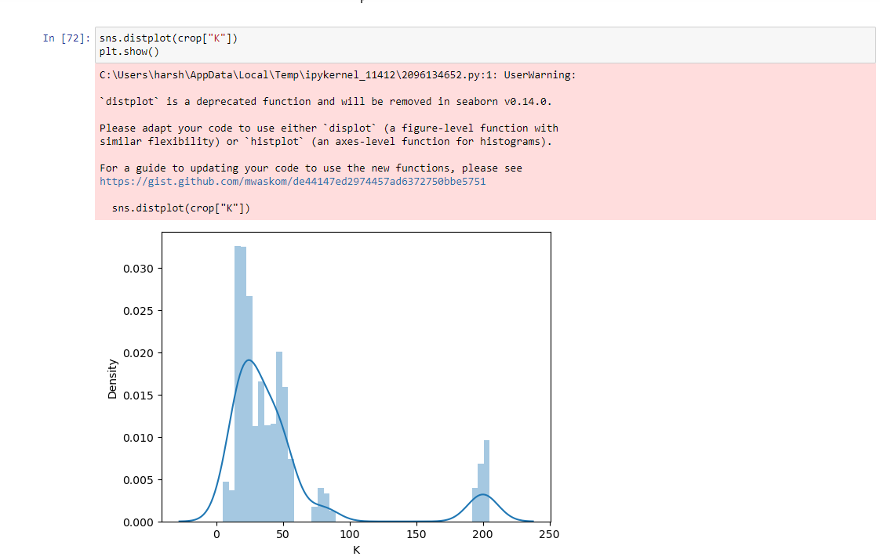
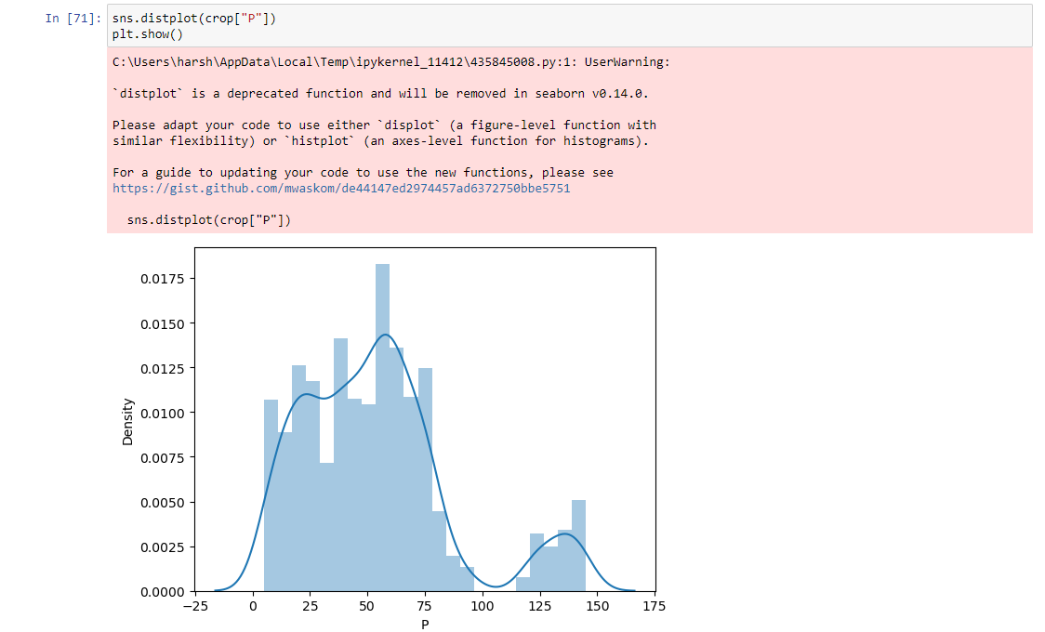
As I mentioned to use python as programming language in this project so this piece of code in converting the data.nc into data.csv format via google colab.
Initial part of the backend development of this project and embedded some insights of the final data of crops with different parameters to predict the best suited crop for the land

Slide 11
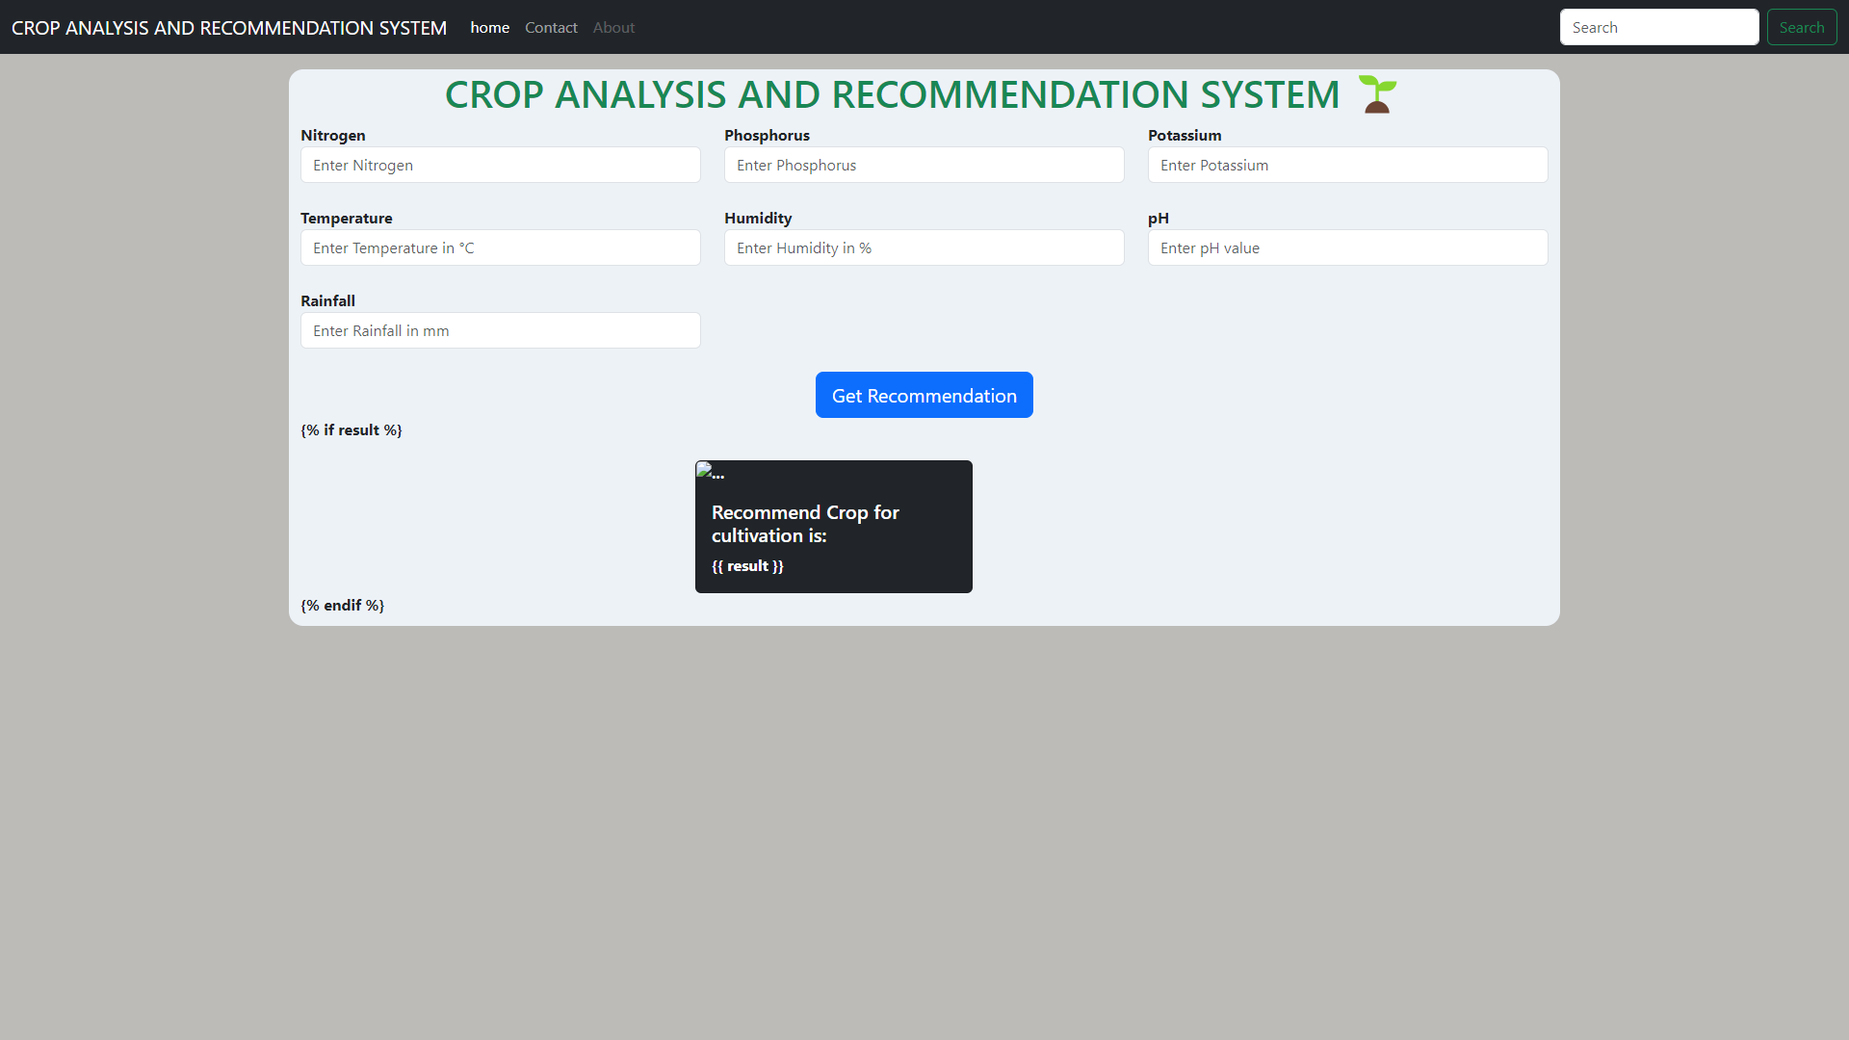
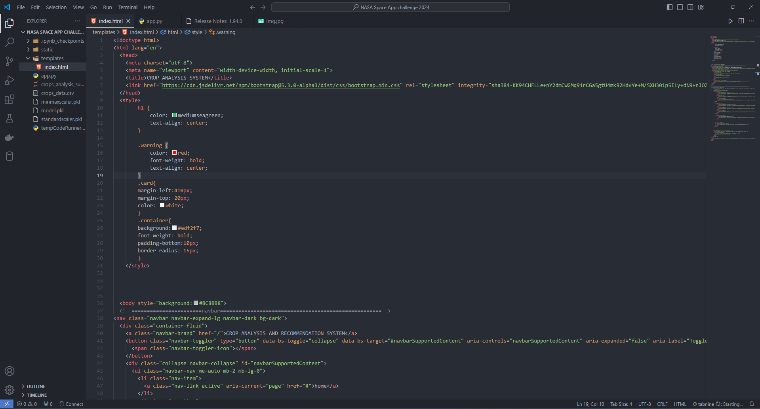
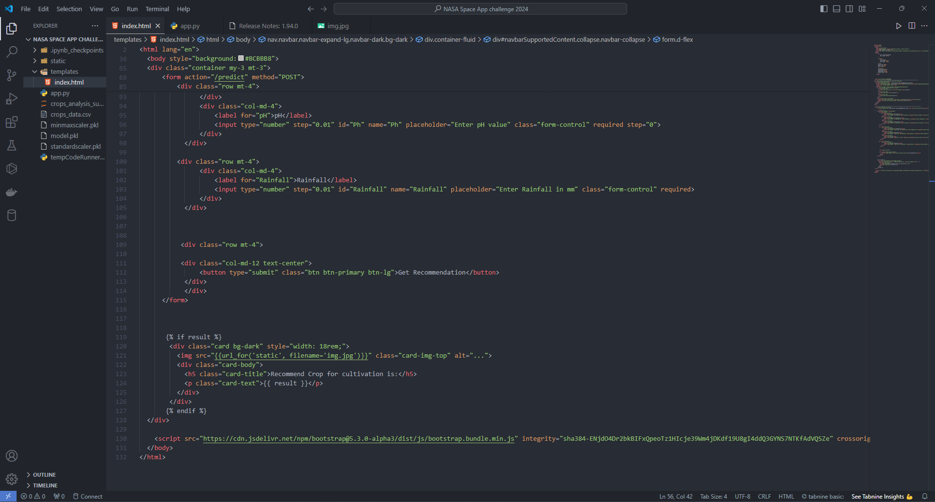
Front end part of this project look likes below which is build using HTML and CSS via VS code
https://github.com/HarshMishra-Git/Temporary_Astro_Analyst
To View the backend of this project I have attached temporary GitHub repo link where the code of backend is present.

Slide 12
Prototype Performance report/Benchmarking
Performance of the Prototype:
Crop yield forecast: 85% accuracy,
Crop stress detection: 90% accuracy,
Best crop recommendation for farmer’s land: 99% accuracy,
Irrigation and fertilizer recommendations: 80% accuracy.
Benchmarking:
Outperformed traditional methods and machine learning-based systems.
Comparable to commercial systems with added value provided by Earth observation data.
Future Development:
Data integration,
Model refinement,
Scalability.

Slide 13
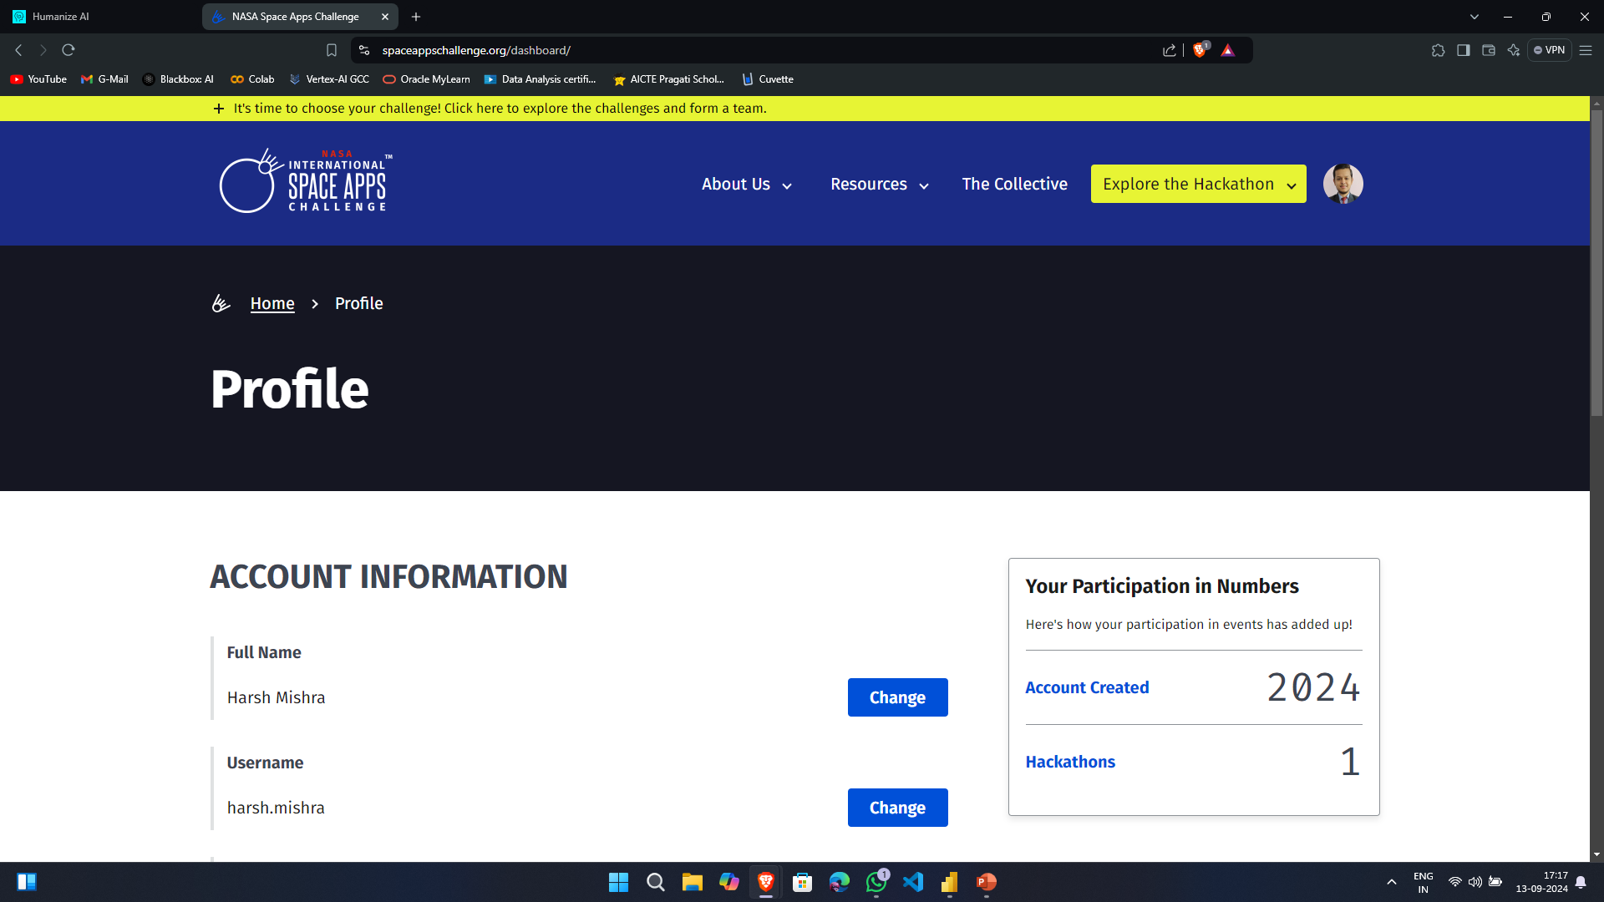
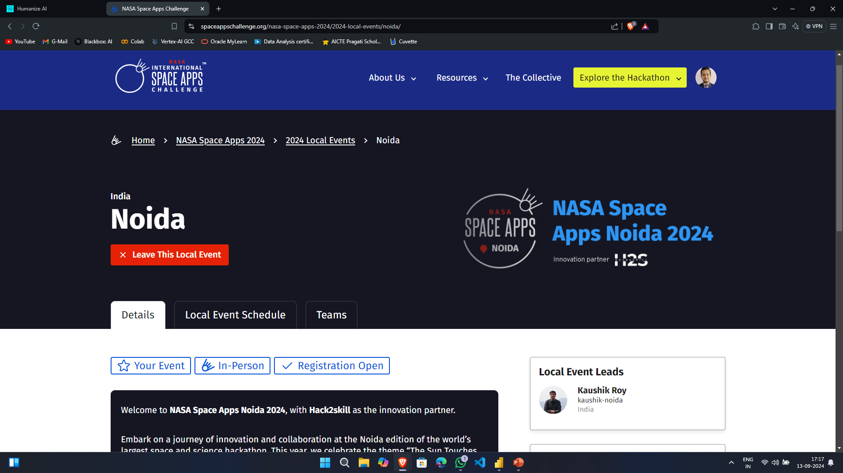
Proof of Registration on https://www.spaceappschallenge.org/nasa-space-apps-2024/2024-local-events/noida
Add screenshots of your registered profile on the above mentioned link.
Screenshots to be added for all of the team members.

Slide 14
